Slide 1


Vector Search Engine

Slide 2
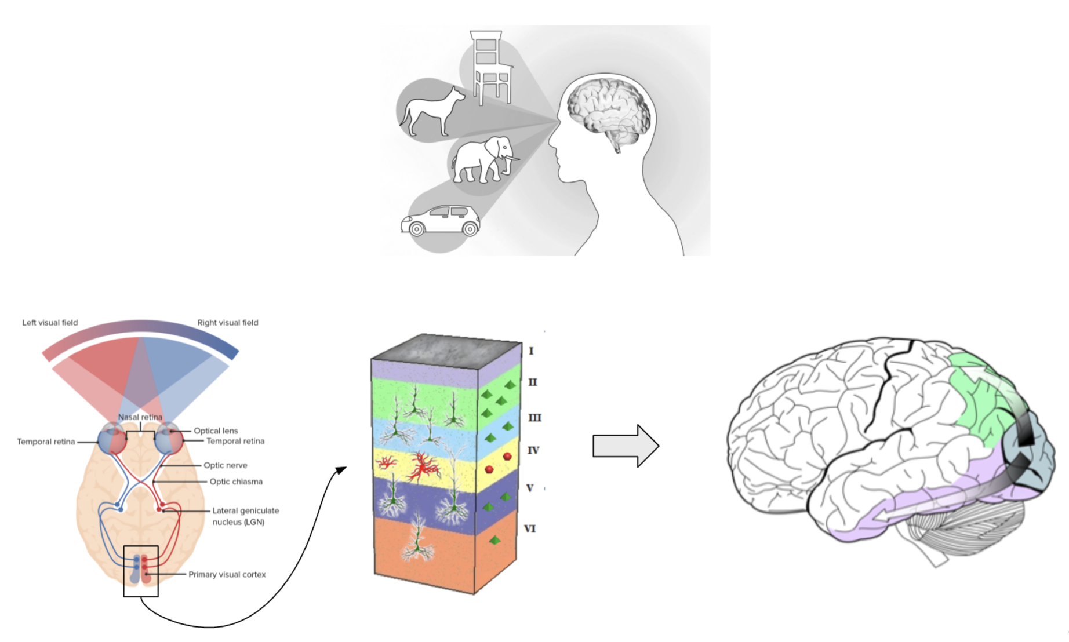
Vector data
Notes:
First lets go through what happens in your brain when you see someone you know?
Describe process of light entering eye
Light enters eye – equivalent to ccd, digital camera, translates light to optical signal
Describe process of converting to signal and where it travels
Signals travel to visual cortex - back of head - optical signal converted to elaborate semantic representation of the image
Cortex layers – describe layers
Connect immediate dots and immediate adjacent pixels together, understand edges
Understand contour and curvature
Differences in depth and shading
Deeper layers in the process – more processed image – more divergent representation
Describe how this is equivalent to vector representation of data
Describe once neural representation in brain is achieved
Data is transferred throughout the brain specifically for visual understanding and recognition
Temporal lobe – Face recognition, Object recognition
Explain reason of telling this
What we see, recognize and remember having seen – object that brain remembers and deals with – little bearing and relation to what we actually see
Rather – rich semantic neural representation from our visual cortex
Important because (next slide while explaining)
Its’ exactly how neural nets and deep learning does data processing and understands the world

Slide 3
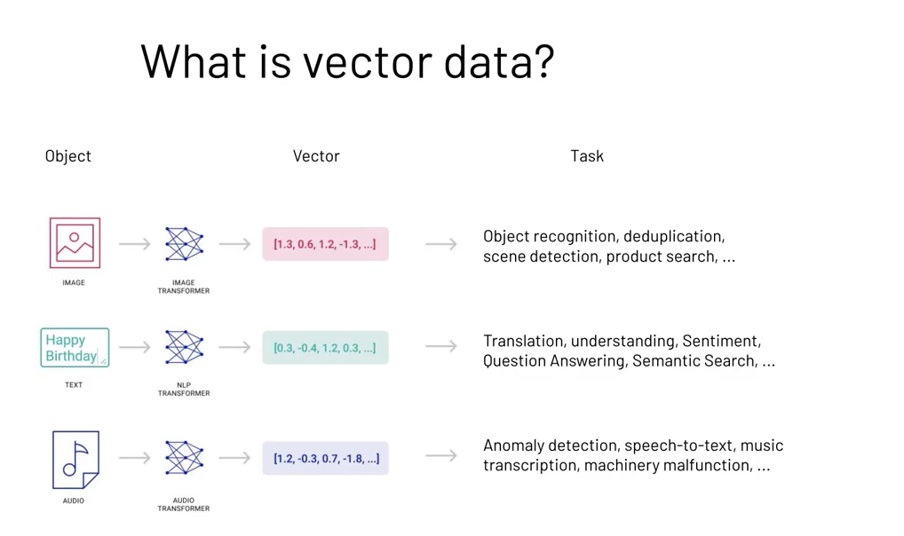
Notes:
Explain and relate image here with in computer
Take images – transform – high dimensional vectors
Vectors – as neural representation or output of the visual cortex
Computer – deep learning model in place of visual cortex – trained on images
Explain once have vector representation
Once we have vector representation – perform higher cognitive tasks
Same as how our brain works - representation – understands remembers and identifies
Same thing is done – computer and machine learning
Vector representations – often called embeddings – and they do *read tasks*
Explain same is done with text
Not just images, same with text
Long text – transformed with language processing models, transformers, etc
Once have embeddings for text – again - *read tasks*
Explain same with audio and many other sources of data including
User behavior etc
In fact, - become standard way of understanding complex objects – world, machine learning, deep learning

Slide 4
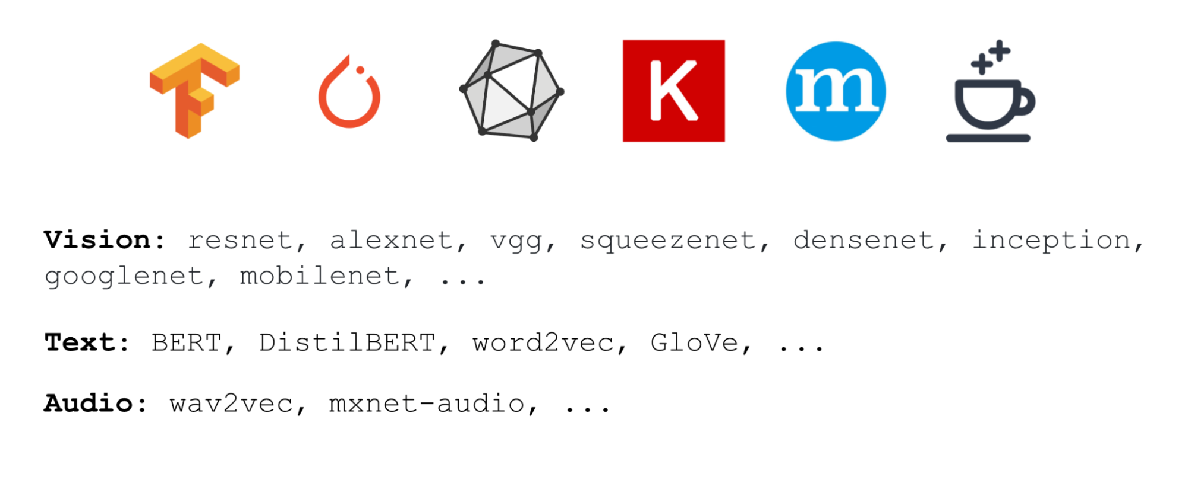

Notes:
This paradigm gained tremendous traction
Standard in many applications
Used in many of the big deep learning applications like tensorflow and pytorch
Have many very well trained models on vision such as *bla bla*
For text some of the more well known ones are *bla bla*
And as for audio *bla bla*
Easy to get – for example
Two lines in python
Download pretrained squeezenet model – computer vision model

Slide 6
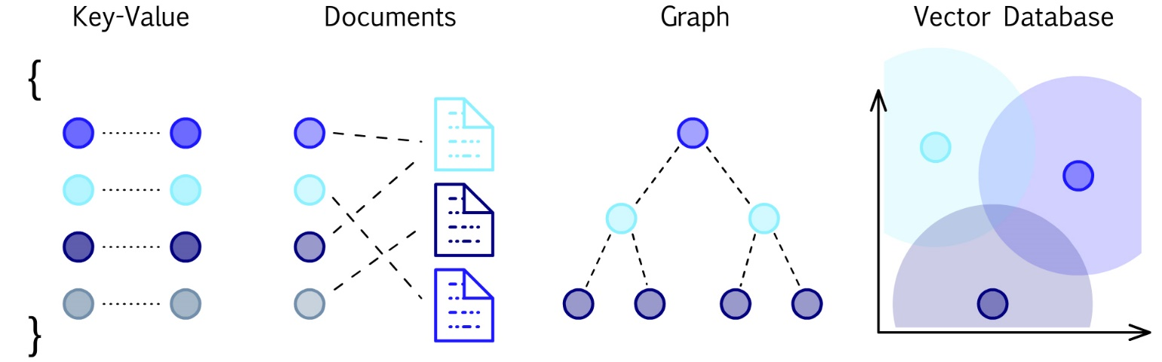



Data Representations

Slide 7
